Slide 1



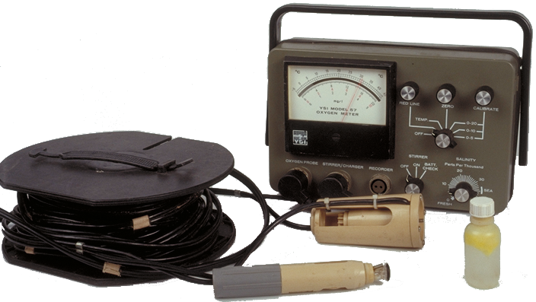

Ecology Series: Set 4
Copyright © 2005
Version: 1.0

Slide 2

The Scientific Method
Scientific knowledge is gained through a process called the scientific method.
This process involves:
  observing and measuring
  hypothesizing and predicting
  planning and executing investigations designed to test formulated predictions.

Slide 3
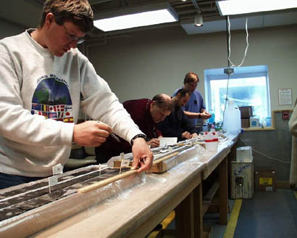
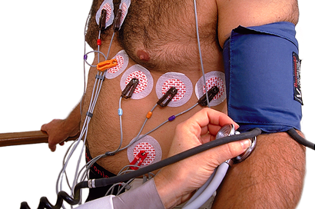

Making Observations
Many types of observation can be made on biological systems. They may involve:
  observation of certain behaviors in wild populations
  physiological measurements made during previous experiments
  ‘accidental’ results obtained when seeking answers to completely unrelated questions
The observations may lead to the formation of questions about the system being studied.
Core sample from McMurdo Sound
Cardiac test

Slide 4
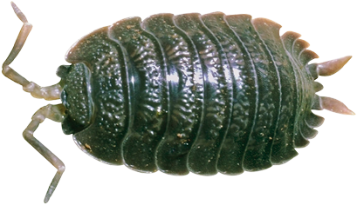
Forming a Hypothesis
Generating a hypothesis is crucial to scientific investigation.
A scientific hypothesis is a possible explanation for an observation, which is capable of being tested by experimentation.
Features of a sound hypothesis are:
  it offers an explanation for an observation.
  it refers to only one independent variable.
  it is written as a definite statement and not as a question.
  it is testable by experimentation.
  it is based on observations and prior knowledge of the system.
  it leads to predictions about the system.
“Moisture level of the microhabitat influences woodlouse distribution”

Slide 5
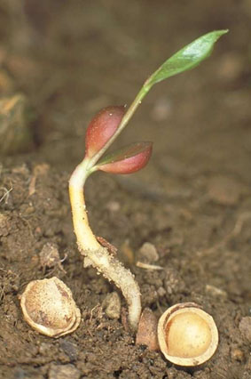
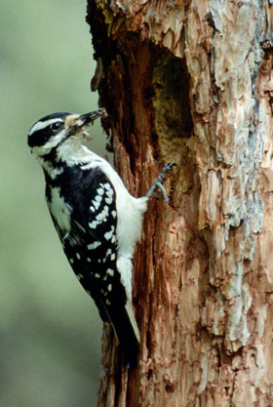
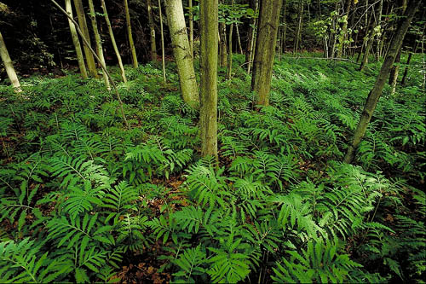
Types of Hypotheses
Hypotheses can involve:
  Manipulation: where the biological effect of a variable is investigated by manipulation of that variable, e.g. the influence of fertilizer concentration on plant growth rate.
  Species preference: where species preference is investigated, e.g. woodpeckers show a preference for tree type when nesting.
  Observation: where organisms are being studied in the field where conditions cannot be changed, e.g. fern abundance is influenced by the
  degree of canopy establishment.

Slide 6

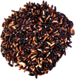


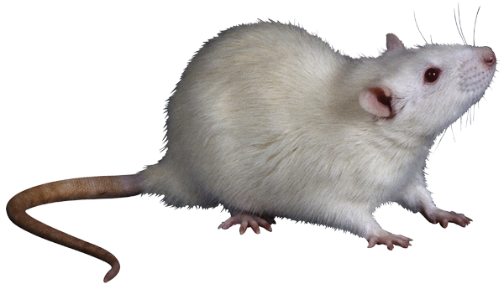
The Null Hypothesis
For every hypothesis, there is a corresponding null hypothesis; a hypothesis against the prediction, of no difference or no effect.
  A hypothesis based on observations is used to generate the null hypothesis (H0). Hypotheses are usually expressed in this form for the purposes of statistical testing.
  H0 may then be rejected in favor of accepting the alternative hypothesis (HA) that is supported by the predictions.
  Rejection of the hypothesis may lead to new, alternative explanations (hypotheses) for the observations.
Scientific information is generated
as scientists make discoveries
through testing
hypotheses.
H0: There is no difference between four different feeds on the growth of newborn rats.

Slide 7
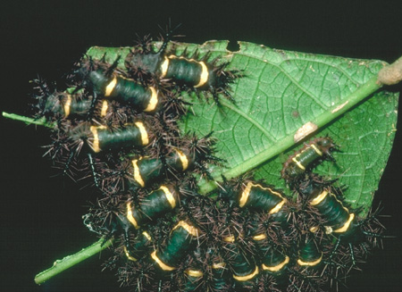
Generating Predictions 1
An observation may generate a number of plausible hypotheses, and each hypothesis will lead to one or more predictions, which can be further tested by further investigation. For example:
Observation 1: Some caterpillar species are brightly colored and appear to be conspicuous to predators such as insectivorous birds.
  Despite their being
  conspicuous, predators
  usually avoid these brightly
  colored species.
  Brightly colored caterpillars
  are often found in groups,
  rather than as solitary animals.
Saddleback caterpillars, Costa Rica

Slide 8
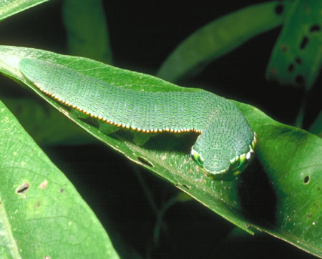
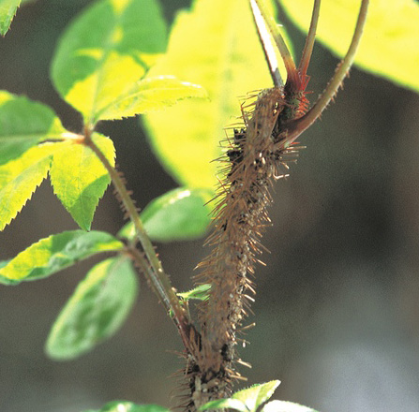
Generating Predictions 2
Observation 2: Some caterpillar species are cryptic in appearance or behavior. Their camouflage is so convincing that, when alerted to danger, they are difficult to see against their background. Such caterpillars are usually found alone.
Swallowtail caterpillar
Caterpillar resembling a stem

Slide 9
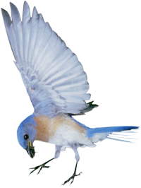


Generating Predictions 3
There are several hypotheses and predictions that could be generated to account for the two previous observations:
  Hypothesis 1: Bright colors signal to potential predators that the caterpillars are distasteful.
    Prediction 1: Inexperienced birds will learn from a distasteful experience with an unpalatable caterpillar species and will avoid them thereafter.
  Hypothesis 2: Inconspicuous caterpillars are palatable and their cryptic coloration reduces the chance that they will be discovered and eaten.
    Prediction 2: Insectivorous birds will avoid preying on brightly colored caterpillars and they will prey readily on cryptically colored caterpillars if these are provided as food.
Bad to eat
Good to eat

Slide 10
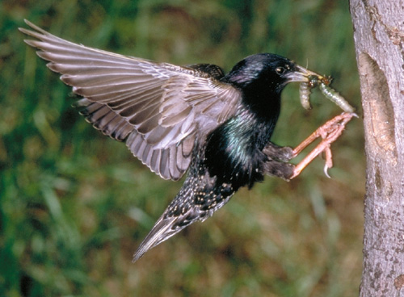
Assumptions
In any experimental work, you will make certain assumptions about the biological system you are working with.
Assumptions are features of the system (and your experiment) that you assume to be true but do not (or cannot) test.
Possible assumptions for the previous hypotheses (and their predictions) include:
  Birds and other predators
  have color vision
  Birds and other predators
  can learn about the palatability
  of their prey by tasting them.

Slide 11
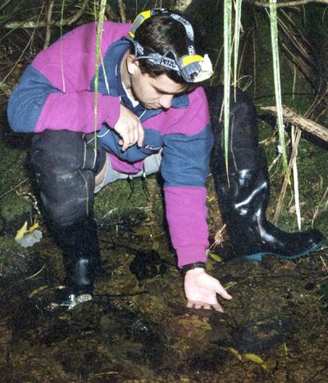

Planning An Investigation
Use a checklist or a template to construct a plan as outlined below:
Preliminary
  Aim and hypothesis are based on
  observation.
  Study is feasible and the chosen
  organism is suitable for study.
Assumptions and variables
  Assumptions and variables have been
  identified and controls established.
  Preliminary treatments or trials have
  been considered.
Data collection
  Any necessary changes have been
  made to the initial plan.
  A results table accommodates all raw data.
  Data can be analyzed appropriately.
Observation is the starting point for any investigation

Slide 12
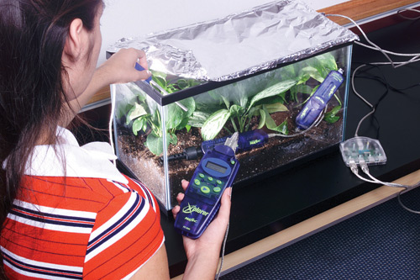
Variables
A variable is any characteristic or property able to take any one of a range of values. Investigations often look at the effect of changing one variable on another (the biological response variable).
It is important to identify all variables in an investigation: independent, dependent, and controlled. Note that there may be nuisance factors of which you are unaware.
In all fair tests, only one
variable (the independent
variable) is changed by
the investigator.
A terrarium experiment using a Pasco datalogger to record data

Slide 13
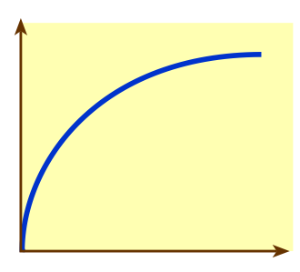

Identifying Variables
All variables (independent, dependent, and controlled) must be identified in an investigation.
Dependent variable
Measured during the investigation. Recorded on the yaxis of the graph.
Dependent variable
Independent variable
Controlled variables
Factors that are kept the same or controlled during the investigation.List these in the method as appropriate to your investigation.
Independent variable
Set by the investigator.Recorded on the X axis of the graph

Slide 14
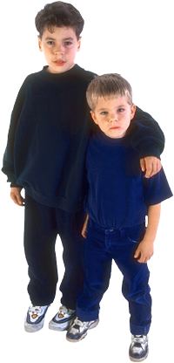
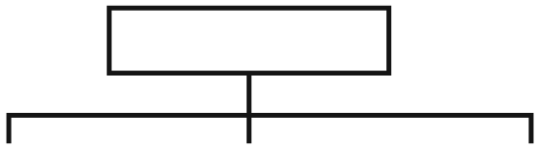

Variables and Data
Data are the collected values for monitored or measured variables.
  Like their corresponding variables, data may be qualitative, ranked, or quantitative (or numerical).
Types of Variables
Qualitative
Non-numerical and descriptive, e.g. sex, color, presence or absence of a feature, viability (dead/alive).
Ranked
Provide data that can be ranked on a scale that represents an order, e.g. abundance (very abundant, common, rare); color (dark, medium, pale).
Quantitative
Characteristics for which measurements or counts can be made, e.g. height, weight, number.
Discontinuous
e.g. Number of children in a family
(3, 0, 4)
Continuous
e.g. Height of children
in a family
(1.5 m, 1.3 m, 0.8 m)
e.g. Sex of children in a family
(male, female)
e.g. Birth order in a family
(1, 2, 3)

Slide 15
Examples of Investigations
Once all of the variables have been identified in an investigation, you need to determine how these variables will be set and measured.
You need to be clear about how much data, and what type of data, you will collect.
  Some examples of investigations are shown below:
Aim |  | Variables
Investigate the effect of varying … | on the following … | Independent variable | Dependent variable
Temperature | Leaf width | Temperature | Leaf width
Light intensity | Activity of woodlice | Light intensity | Woodlice activity
Soil pH | Plant height at age 6 months | pH | Plant height

Slide 16
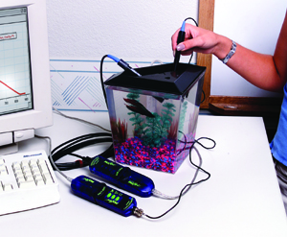
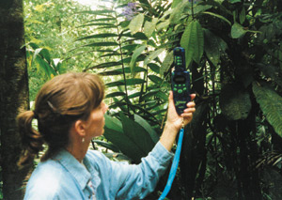
Stages In An Investigation
Investigations involve written stages (planning and reporting), at the start and end. The middle stage is the practical work when the data are collected (in this case by dataloggers as shown below).
Practical work may be based in the laboratory or in
the field (the natural system).
  Typically lab work involves investigating
  how a biological response is affected by
  manipulating a particular variable.
  Field work often involves investigating features
  of a population or community. Investigations in
  the field are usually more complex than those in
  the lab because natural systems have many
  more variables that cannot easily be controlled.
Photos: Pasco

Slide 17
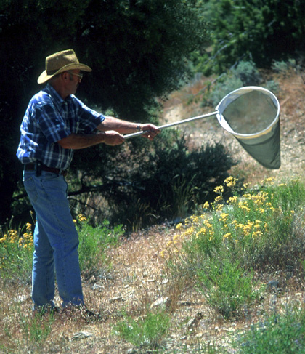
Field Studies
A framework for a simple field study is outlined below:
  Observation
  Aim and hypothesis
  Sampling program; in field studies, a
  sampling unit may consist of a single
  individual or (for example) a quadrat
  and the sample size can be very
  large (e.g. n = 100 individuals).
  Equipment and procedure
  Assumptions
A checklist for the design of a
field study should be completed
prior to embarking on the
investigation.
Collecting individuals using a sweep net

Slide 18
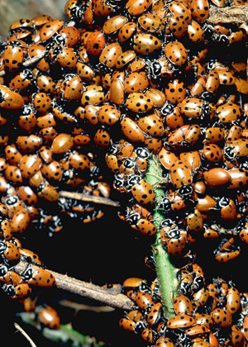
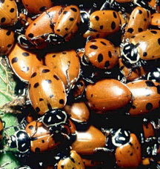
Sample Size
Ladybird population
When designing your field study, the size of your sampling unit and the sample size (n) should be major considerations.
  A sampling unit might be (for example) an individual organism or a quadrat.
  The sample size might be the number of individuals or the number of quadrats.
For field studies, sample size is often determined by the resources and time available to collect and analyze your data.
It is usually best to take as many samples as you can, as this helps to account for any natural variability present and will give you greater confidence in your data.
Sample (n=23)

Slide 19
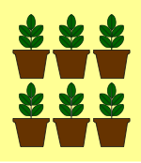
Replication
Replication in experiments refers to the number of times you repeat your entire experimental design (including controls).
  Increasing the sample size (n) is not the same as true replication. In the replicated experiment below, n=6.
Watering regime
150 ml per day water at pH 3
Watering regime
150 ml per day water at pH 5
Watering regime (control)
150 ml per day water at pH 7
Watering regime
150 ml per day water at pH 9
Watering regime
150 ml per day water at pH 3
Watering regime
150 ml per day water at pH 5
Watering regime (control)
150 ml per day water at pH 7
Watering regime
150 ml per day water at pH 9

Slide 20
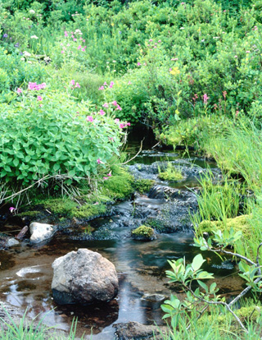
Making Investigations 1
An example of a basic experimental design aimed at investigating effect of pH on the growth of a bog adapted plant species follows:
Observation: A student noticed an
abundance of a common plant (species A)
in a boggy area of land. The student tested
the soil pH and found it to be quite low
(between 4 and 5). Garden soil was about
pH 7.
Hypothesis: Species A is well adapted to
grow at low pH and pH will influence the
vigor with which this plant species grows.
Prediction: Species A will grow more
vigorously (as measured by wet weight
after 20 days) at pH 5 than at lower or a
higher pH.
Species A

Slide 21

Making Investigations 2
Experiment: An experiment was designed to test the prediction that the plants would grow best at low pH. The design is depicted graphically below and on the next slide. It is not intended to be a full methodology.
Fluorescent strip lighting
Fluorescent strip lighting
Watering regime
150 ml per day water
at pH 3
Watering regime
150 ml per day water
at pH 5
Watering regime
150 ml per day water
at pH 7 (control)
Watering regime
150 ml per day water
at pH 9

Slide 22
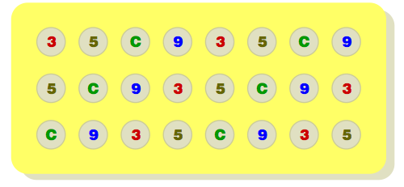
Making Investigations 3
Each treatment contains 6 plants (n = 6)
Plan view of the experimental layout
3 = pH 3
5 = pH 5
C = control (pH 7)
9 = pH 9.
Note that in experiments with a large number of treatments and replication, it is important to randomize the arrangement of the treatments to account for any effects of location in the set-up.
  In this case, n = 6, there are four different treatments and the experiment has been replicated six times.

Slide 23
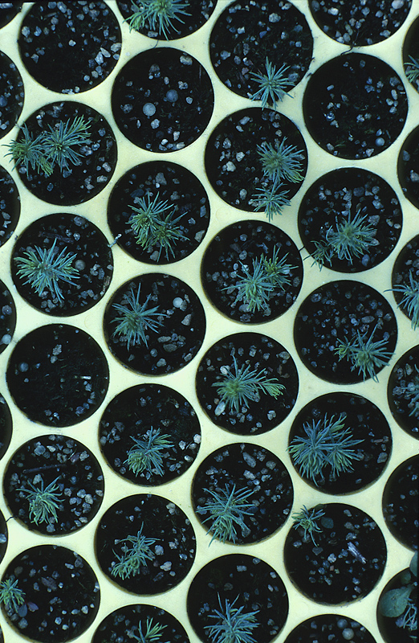
Making Investigations 4
Control of variables:
  Fixed variables include lighting and watering regime, soil type and volume, age and history of plants, pot size and type.
  The independent variable is the pH of the water provided to the plants.
  The dependent variable is plant growth rate
  (g day⁻¹) calculated from wet weight of entire plants (washed and blotted) after 20 days.
  Other variables include genetic variation between plants and temperature.
Assumptions include: All plants are essentially no different to each other in their growth response at different pH levels; the soil mix, light quality and quantity, temperature, and water volume are all adequate for healthy continued growth.
Certain variables, such as pot size and plant age, can be fixed when plants are grown under controlled conditions

Slide 24
Collection and Analysis
Data collected by measuring or counting in the field or laboratory are called raw data.
  As part of planning an investigation, a suitable results table must be designed to record raw data.
Once all the required data has been collected, they need to be analyzed and presented.
  To do this, it may be necessary to transform the data first.
Raw data may be collected in the field

Slide 25
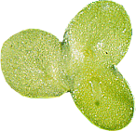
Data Transformations
Data are often transformed as a first step in the analysis of results.
  Transforming data can make them more useful by helping to highlight trends and make important features more obvious.
Transformations include drawing a frequency table, or performing a calculation such as a total, rate, percentage, or relative value.
  Calculation of a rate is a commonly performed data transformation, and is appropriate when studying the growth of an organism (or population).
  Biological investigations often compare the rates of events in different situations, as shown in the example right.
Photosynthetic rate at different light intensities
Light intensity (%) | Average time for leaf disc to float (min) | Reciprocal of time (min^{–1})
100 | 15 | 0.067
50 | 20 | 0.050
25 | 60 | 0.017
11 | 85 | 0.012
6 | 190 | 0.005

Slide 26
Constructing Tables 1
Data can be presented in a number of ways.
  Tables provide an accurate record of numerical values and allow organization of data in a way that makes relationships and trends apparent. An example of a well constructed table is shown below:
 | Table 1: Length and growth of the third internode of bean plants receiving three different hormone treatments (data are given ± standard deviation).
Treatment |  | Sample size | Mean rate of internode growth (mm day^{–1}) | Mean internode length (mm) | Mean mass of tissue added (g day^{–1})
Control |  | 50 | 0.60 ± 0.04 | 32.3 ± 3.4 | 0.36 ± 0.025
Hormone 1 |  | 46 | 1.52 ± 0.08 | 41.6 ± 3.1 | 0.51 ± 0.030
Hormone 2 |  | 98 | 0.82 ± 0.05 | 38.4 ± 2.9 | 0.56 ± 0.028
Hormone 3 |  | 85 | 2.06 ± 0.19 | 50.2 ± 1.8 | 0.68 ± 0.020

Slide 27
Constructing Tables 2
The rules for constructing tables are shown below:
Tables should have an accurate, descriptive title. Number tables consecutively through the report
Independent variable in left column
Table 1: Length and growth of the third internode of bean plants receiving three different hormone treatments (data are given ± standard deviation).
Treatment | Sample size | Mean rate of internode growth (mm day^{–1}) | Mean internode length (mm) | Mean mass of tissue added (g day^{–1})
Control | 50 | 0.60 ± 0.04 | 32.3 ± 3.4 | 0.36 ± 0.025
Hormone 1 | 46 | 1.52 ± 0.08 | 41.6 ± 3.1 | 0.51 ± 0.030
Hormone 2 | 98 | 0.82 ± 0.05 | 38.4 ± 2.9 | 0.56 ± 0.028
Hormone 3 | 85 | 2.06 ± 0.19 | 50.2 ± 1.8 | 0.68 ± 0.020
Heading and subheadings identify each data and show units of measurement
Control values should be placed at the beginning of the table
Tables can be used to show a calculated measure of spread of the values about the mean (e.g. standard deviation)
Each row should show a different experimental treatment, organism, sampling site etc.
Columns that need to be compared should be placed alongside each other
Show values only to the level of significance allowable by your measuring technique
Organize the columns so that each category of like numbers or attributes is listed vertically

Slide 28
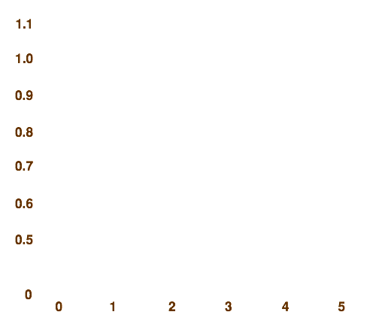
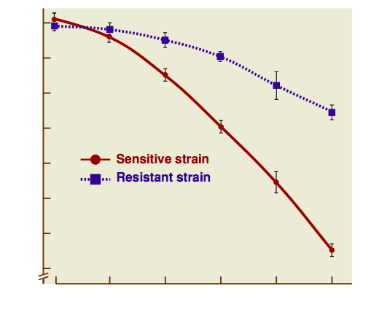
Constructing Graphs 1
Graphs are useful for providing a visual image of trends in the data in a minimum of space.
Fig. 1: Yield of two bacterial strains at different antibiotic levels. Vertical bars show standard errors (n = 6)
Yield (absorbance at 550 nm)
Antibiotic (g m^{–3})

Slide 29
Constructing Graphs 2
The rules for constructing graphs are shown below:
Graphs (called figures) should have a concise, explanatory title. They should be numbered consecutively in your report
Plot points accurately. Different responses can be distinguished using different symbols, lines or bar colors.
Fig. 1: Yield of two bacterial strains at different antibiotic levels. Vertical bars show standard errors (n = 6)
The spread of the data around the plotted mean value can be shown on the graph. Such measures include standard deviation and range. The values are plotted as error bars and give an indication of the reliability of the mean value.
Label both axes
(provide SI units of measurement if necessary)
The dependent variable e.g. biological response, is plotted on the vertical (y) axis
Yield (absorbance at 550 nm)
A key identifies symbols. This information sometimes appears in the title.
A break in an axis allows economical use of space if there are no data in the “broken” area. A floating axis (where zero points do not meet) allows data points to be plotted away from the vertical axis.
Each axis should have an appropriate scale. Decide on the scale by finding the maximum and minimum values for each variable.
Antibiotic (g m^{–3})
The independent variable, e.g. treatment, is on the horizontal (x) axis

Slide 30
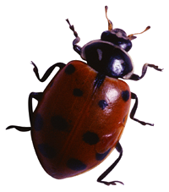
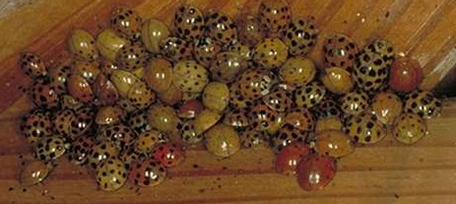
Descriptive Statistics 1
Descriptive statistics, such as mean, median, and mode, can be used to summarize data and provide the basis for statistical analysis.
  Each of these statistics is appropriate to certain types of data or distributions, e.g. a mean is not appropriate for data with a skewed distribution.
Standard deviation and standard error are statistics used to quantify the amount of spread in the data and evaluate the reliability of estimates of the true (population) mean (µ).
Mean (average) carapace width of these beetles is 4 mm. But what is the variation in this this statistic in the population?

Slide 31
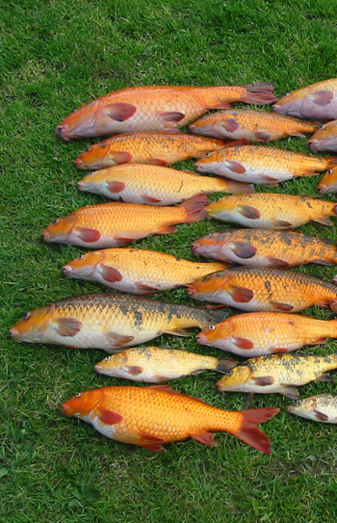
Descriptive Statistics 2
In a set of data values, it is useful to know the value around which most of the data are grouped; the center value.
Basic descriptive statistics can summarize trends in your data.
Statistic | Definition and use | Method of calculation
Mean | Average of all data entries. Measure of central tendency for normal distributions | Add all data entries Divide by the number of entries
Median | Middle value when data are in rank order. Measure of central tendency for skewed distributions. | Arrange data in increasing rank order. Identify the middle value.
Mode | Most common data value. Good for bimodal distributions and qualitative data. | Identify the category with the highest number of data entries.
Range | The difference between the smallest and largest data values. Gives a crude indication of data spread. | Identify largest and smallest values and calculate the difference between them.
Is this fish catch normally distributed?
Brendan Hicks

Slide 32
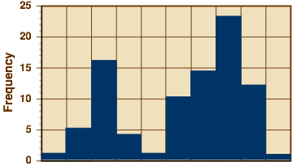
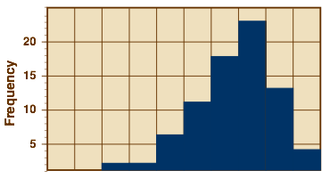
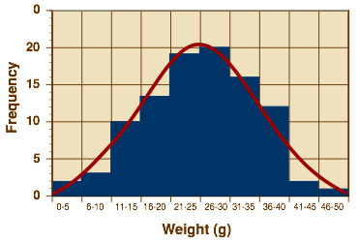
Frequency Distributions
Bimodal distribution
Variability in continuous data is often displayed as a frequency distribution.
A frequency plot will indicate whether the data have a normal distribution, or whether the data is skewed or bimodal.
The shape of the distribution will determine which statistic (mean, median, or mode) best describes the central tendency of the sample data.
Skewed distribution
Normal distribution

Slide 33
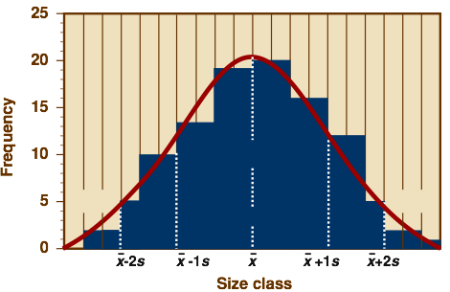

Measuring Spread
Standard deviation (s) is a frequently used measure of the variability (spread or dispersion) in a set of data. Two different sets of data can have the same mean and range, yet the distribution of data within in the range can be quite different.
  In a normally distributed set of data:
    68% of all data values will
    lie within one standard
    deviation of the mean;
    95% of all data values will
    lie within two standard
    deviations of the mean.
The variance (s ²) is another such measure of dispersion but the standard deviation is usually the preferred of these two measures.
Normal distribution
68%
2.5%
2.5%
95%

Slide 34
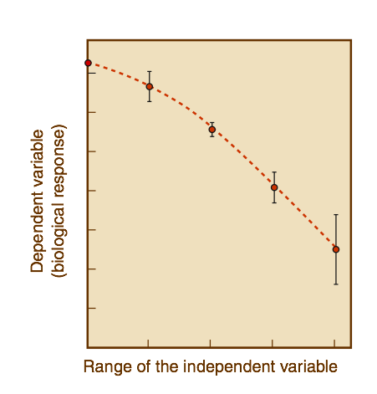
The Reliability of the Mean
The reliability of the sample mean (x) as an estimate of the true population mean can be indicated by the calculation of the standard error of the mean (standard error or SE). The standard error then allows the calculation of the 95% confidence interval (95% CI) which can be plotted as error bars.
The 95% confidence limits are given
by the value of the mean ± 95%CI.
  A 95% confidence limit (i.e. P = 0.05)
  tells you that, on average, 95 times
  out of 100, the true population mean
  will fall within these limits.
  For example, if we calculated the mean
  number of spots on 10 ladybirds, the
  95%CI will tell us how reliable that statistic
  is as an indicator of the mean number of
  carapace spots in the whole population.
Confidence limits are given by x ± 95%CI
trendline
small 95% CI
mean
large 95% CI

Slide 35
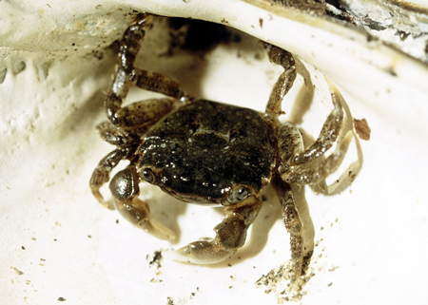
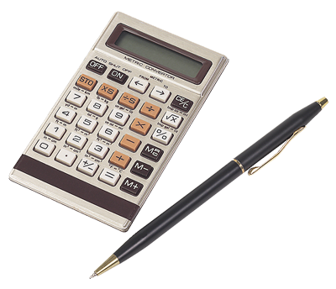
Statistical Tests
Different statistical tests are appropriate for different types of data. The type of data collected will determine how/if it can be tested.
The null hypothesis of no difference
or no effect can be tested statistically and may then be rejected in favor of accepting the alternative hypothesis that is supported by the predictions.
Statistical tests may test for:
  a difference between treatments or groups
  a trend (or relationship) in the data, for example, correlation and regression.
The weight change of shore crabs held at different salinities can
be analyzed statistically
using a regression

Slide 36
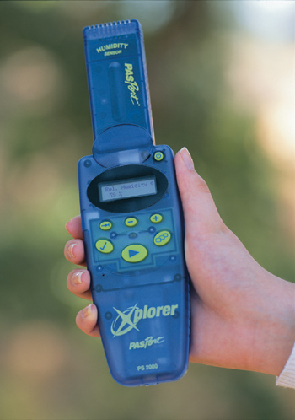
Monitoring Physical Factors
Devices for measuring the physical factors in the field include the following meters and equipment:
  Quantum light meter
  Dissolved oxygen and oxygen meter
  pH meter
  Total dissolved solids (TDS) meter
  Current meter
  Hygrometer
  Wind meter
  Secchi disc
  Nansen bottle
Handheld dataloggers with multiple
or multi-function probes are
increasingly replacing older style,
single function meters.
Photo: Pasco
Hand held datalogger with humidity probe

Slide 37
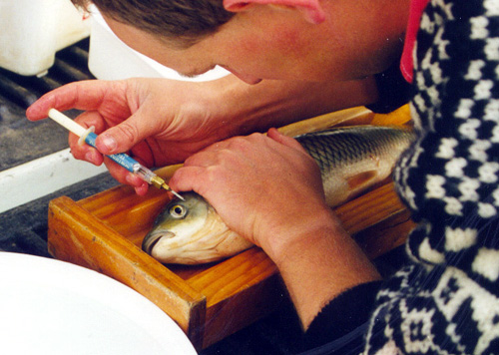

Sampling Populations
Generally populations are too large to be examined directly (by direct count or measurement of all the individuals in the population), but they must be sampled in a way that still provides representative information about them.
Most studies in population ecology involve collecting living organisms. Sampling techniques must be appropriate to the community being studied and the information
required by the investigator.
  Sampling techniques include:
    point sampling
    transect (line and belt)
    quadrat sampling
    mark and recapture
Photo: Brendan Hicks
Inserting a visual implant tag in a mark and recapture study of carp

Slide 38
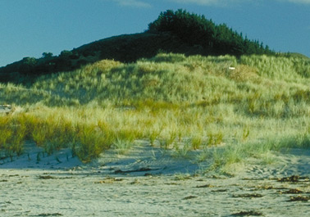
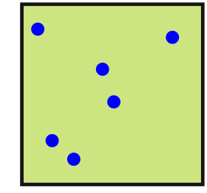
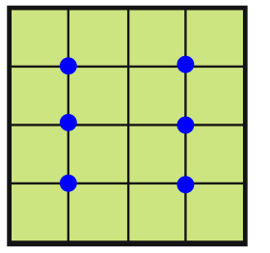
Point Sampling
Point sampling is a technique where individual points are chosen on a map (using a grid reference or random numbers applied to a map grid) and the organisms are sampled at those points.
  It is used to determine species abundance and community composition.
  If the samples are large enough, population characteristics (e.g. age structure, reproductive parameters) can be determined.
Sand dune community
Random
Systematic (grid)

Slide 39
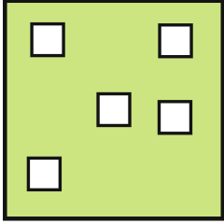
Quadrat Sampling
Quadrat sampling is a method by which organisms in a certain set proportion (sample) of the habitat are counted or measured directly.
  It can be used to determine community and population composition, including abundance, species density and distribution, frequency of occurrence, percentage cover (of plants) and biomass (if harvested).
Quadrats may be used without a transect when studying a relatively uniform habitat. The quadrat positions are chosen randomly using a random number table.
Table of random numbers
 | A |  | B |  | C |  | D
 | 22 |  | 31 |  | 62 |  | 22
 | 32 |  | 15 |  | 63 |  | 43
 | 31 |  | 56 |  | 36 |  | 64
 | 46 |  | 36 |  | 13 |  | 45
 | 43 |  | 42 |  | 45 |  | 35
 | 56 |  | 14 |  | 31 |  | 14
Quadrat
Area being sampled

Slide 40
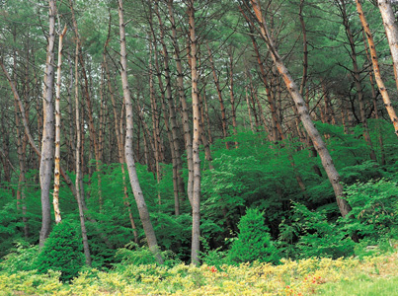
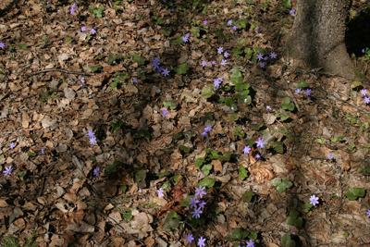
Quadrat Use
The area of each quadrat must be known exactly. Ideally, quadrats should be the same shape.
Enough quadrat samples must be taken to provide results that are representative of the total population in the area.
Count or measurement procedure must be decided beforehand and species must be distinguishable from each other.
The size of the quadrat should be
appropriate to the organisms and
habitat, e.g. large for trees, small
for leaf litter.
Larger quadrats are needed to be representative of forested areas
Smaller quadrats may be suitable when the species studied, such as these wildflowers, are small

Slide 41
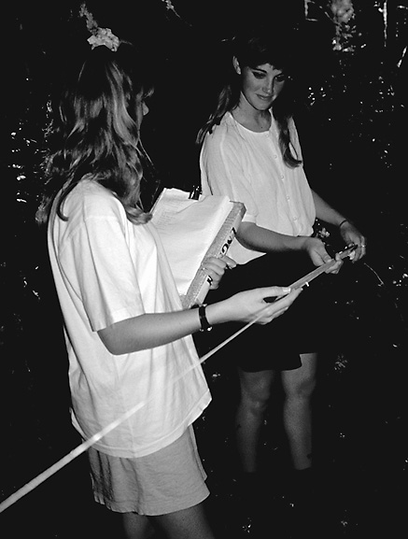


Line Transects
A line transect is a sampling line placed
across a community.
Transects are used to determine changes in
community composition (species distribution)
along an environmental gradient.
Line transects are drawn across a map, and
organisms occurring along the line are sampled.
  A line transect uses a tape
  or rope to mark the line, and
  the species occurring on the
  line are recorded.
  The line(s) can be chosen
  randomly, or may follow
  an environmental gradient
  (such as a rise in altitude).
Random transect
Non-random transect

Slide 42

Belt Transects
Belt transects are basically a form of continuous quadrat sampling.
  They provide more information on community composition than a line transect but can be difficult to carry out.
  A measured strip is located across the study area. Quadrats are used to sample the plants and animals at regular intervals along the belt.
In a continuous belt transect,
the quadrats are placed adjacent
to each other in a continuous belt.
In an interrupted belt transect,
the quadrats are placed at regular
intervals along the transect line.
0.5 m
Environmental gradient
Belt transect

Slide 43



Types of Transects
Point sampling on a line transect
Sample point
Sample point
Sample point
Sample point
Sample point
Sample point
Sample point
Sample point
Continuous belt transect
Interrupted belt transect
Line of transect
4 quadrats across each sample point

Slide 44




Kite Graphs
Kite graphs are used to represent distributional data, for example, abundance along an environmental gradient.
Kites are elongated figures
drawn along a baseline.
Each kite represents
changes in species
abundance across an area.
Species abundance is
calculated by the width of
the kite.
Distance from the low water mark (m)
Kite width
Number of individuals or percentage cover
Species A
Species B
Species C

Slide 45





Mark and Recapture
Mark and recapture is used to determine the total population density for highly mobile species in a certain area.
  For a precise population estimate, mark-recapture methods require that about 20% of the population is marked, which can be difficult. Also, marking is difficult for small animals.
First capture
Release
Second capture
In the first capture, a random sample of animals from the population is selected. Each selected animal is marked in a distinctive way.
The marked animals from the first capture are released back into the natural population and left to mix with the unmarked individuals.
The population is sampled again; only a proportion of the second capture sample will have animals that were marked in the previous capture.

Slide 46

The Lincoln lndex
This equation is used to estimate the size of the overall population.
The Lincoln Index
No. of animals in 1st sample
X Total no. of animals in 2nd sample
Total population =
Number of marked animals in the second sample (recaptured)
The population is sampled by capturing as many of
the individuals as possible and practical.
Each animal in the sample is marked to distinguish it
from unmarked animals.
Animals are returned to their habitat and left to mix
with the rest of the population.
The population is sampled again (this need not be
the same sample size as the first, but it must be
large enough to be valid).
The numbers of marked to unmarked animals in this
second sample is determined. The Lincoln Index is
used to estimate overall population size.
Tagging a monarch butterfly for recapture

Slide 47


Removal Method
The removal method offers a simple, little known alternative to mark-recapture to estimate population size.
Two or more samples are taken without replacement, and the number of individuals in each sample is counted separately.
For this example, the number of kowhai
larvae (caterpillars) feeding on (and
defoliating) a dwarf kowhai tree was
estimated using the removal method.
The caterpillars were removed in
successive samplings.
Kowhai moth (Uresiphitia polygonalis
maorialis) is a New Zealand native
found throughout the countryside where
its spotted larvae feed on legumes such
as kowhai, broom, lupin, and gorse.
Kowhai moth larva (left) and its host plant (above)

Slide 48

Removal Estimates
Damage caused by kowhai moth larvae (arrowed)
Population estimates become increasingly reliable as more removal passes are made.
Calculation of population densities using removal methods is mathematically involved (see a biological statistics text). It is best used where mark-recapture is not feasible or practicable.
Removal sample | No. of caterpillars removed in each sample | Sum of removed caterpillars | Population estimate
1 | 189
2 | 140 | 329 | 729
3 | 76 | 405 | 554
4 | 31 | 436 | 493
5 | 14 | 450 | 475

Slide 49

Indirect Sampling 1
Indirect sampling is often used for studying widely dispersed, easily disturbed, or elusive animals.
Indirect sampling is preferable when direct sampling is difficult or could cause undue harm to the organisms involved.
Indirect sampling can provide a ‘best guess’ of population attributes but estimates made this way are less accurate than those made using other methods. Indirect methods include:
  counts/analysis of scats (feces)
  monitoring calls
  tracks, markings, scrapes
  electronic devices
  burrows, probe holes, nests

Slide 50



Recording Sheets
When recording sheets or reporting cards are used, indirect sampling can also provide information on habitat use and range, and enable biologists to link habitat quality to species presence or absence.
  In Australia, a frog census datasheet
  is available and volunteers record
  information about frog populations
  and habitat quality in areas they visit.
  A similar program operates
  for kiwi in New Zealand.

Slide 51

Sampling Animal Populations
Unlike plants, most animals are highly mobile and require equipment specially designed to capture or trap them.
Animal sampling equipment ranges from various types of nets and traps to more complex electronic
devices such as those used for
radio-tracking. Equipment and
sampling methods include:
  Beating tray and sweep nets
  Plankton nets, fyke nets, seine nets
  Small mammal traps
  Nansen water bottle (water sampler)
  Pooter (aspirator)
  Tullgren funnel
  Pitfall trap
  Kick sampling (stream invertebrates)
Throwing a fyke net
Photo: Brendan Hicks

Slide 52


Pitfall Traps
Pitfall traps provide a qualitative sample of ground dwelling invertebrates.
Pitfall traps rely on being placed in an area where the organisms of interest are active.
  The take no account of clumped distributions or microhabitat preference.
  They may overestimate the abundance of organisms in some areas and underestimate it in others.
Flat rock
Support
Ground slopes away to assist drainage
Photo: University of Maryland-Baltimore County www.umbc.edu
Jar sunk in the ground
50% ethanol may be added as an immobilzer
Pitfall trap in the forest

Slide 53

Tullgren or Berlese Funnels
A Tullgren or Berlese (Bur-LAY-zee) funnel provides a means of capturing small invertebrates from soil or leaf litter based on light or heat avoidance behavior.
It may be quantitative if a known volume
of litter/soil is sampled.
  Tullgren and Burlese funnels are biased
  towards species showing the avoidance
  behavior and those small enough to pass
  through the gauze mesh.
Light
Large diameter funnel with gauze platform
Leaf litter containing invertebrates
Berlese funnels are simple to make with just a lamp, a funnel, and a soda bottle
Collecting jar

Slide 54


Pooter (Aspirator)
A pooter or aspirator provides a means of capturing small invertebrates from leaf litter.
This method may be quantitative if a known volume of litter is sampled.
Glass collecting tube that sucks up small animals
Clear plastic tube
Photo: University of Miami, Oxford, Ohio
Rubber or cork bung
Gauze covering the opening of the tube
Pooter in use
Specimen tube
Glass mouthpiece through which operator sucks

Slide 55




Sampling in Vegetation
Invertebrates in vegetation can be sampled qualitatively using sweep nets or beating trays.
Vegetation is shaken or beaten with a stick
Photo: The Wildlife Trust, UK, www.wildlifetrust.org.uk
Falling invertebrates are caught on stretched canvas
Net is swept through low vegetation
Stout canvas attached to stiff hoop can withstand rough treatment

Slide 56


Sampling Fish
Nets for fish can act as passive traps, or they can be actively pulled through the water to capture organisms in their path. Common types include:
  Hoop or fyke nets are constructed of hoops of ever-decreasing size. They act as a passive trap; the fish enter the net and are trapped at its base.
  Seine nets are pulled through the water and trap fish in the mesh.
Fyke net
Seine netting
Photos: Brendan Hicks, CBER, University of Waikato

Slide 57


Invertebrates in Water
Aquatic invertebrates can be sampled using a variety of methods:
  Plankton nets provide quantitative samples of
  zooplankton from ponds and lakes. The volume filtered can
  be calculated using the length and diameter of the net and
  the lake depth. Smaller sized meshes will capture smaller
  species and life stages.
  Kick sampling is a simple but effective way to provide
  semi-quantitative samples of invertebrates in streams.
Tow rope
Bridle
Invertebrates are dislodged and collect in the net
Direction of current
Cone of bolting silk
Plastic container for collecting plankton sampling
Rocks upstream of the net are disturbed

Slide 58


Small Mammal Traps
Mammals are more difficult to trap than invertebrates because they are more evasive and intelligent.
Longworth traps provide a qualitative assessment of small mammal populations in an area.
  Such traps may be biased because of trap avoidance in some species.
Nest box containing bedding, angled to prevent flooding
Trap entrance (door closed)
Tunnel

Slide 59


Water Sampling
A water sampler, such as a Nansen bottle, provides a quantitative sample of water from a certain, measured depth in a lake.
  Water samples can be used for chemical,
  bacterial, or phytoplankton analyses.
Tube allows air to escape
Line is pulled to remove bung
Photo: John Green
When bung is removed, water flows into the bottle
Using a Nansen bottle to sample a layer of purple sulfur bacteria, Mahoney Lake, British Columbia
Weight

Slide 60


Radio-Tracking
Radio-tracking is a non-invasive electronic method for examining the population attributes and habitat use of a wide range of animal species (including endangered and pest species).
  A small transmitter with an antenna is attached to the animal and a receiver picks up an emitted signal giving the animal’s position. A tracking antenna can also be used with the receiver.
Photos: Sirtrack
Adelie penguins with transmitters
Brushtail possum with transmitter

Slide 61


Tracking Native Animals
Radio-tracking devices are used widely in many aspects of conservation work. They can be used to study the movements and habitat use of native animals.
  The findings of radio-tracking studies of tuatara indicated that they will use artificial burrows after translocation to offshore islands. The studies also showed that captive reared individuals have different dispersal patterns to those moved directly from the wild.
Photos: Sirtrack
Male tuatara with transmitter
Long tailed bat wearing transmitter

Slide 62


Other Electronic Sampling Devices
Electrofishing. This is an effective method of sampling larger aquatic animals, such as fish. In the photo, the operator has a portable battery backpack and carries an anode probe and a net. The animals are stunned but unhurt.
Electronic detection devices. These devices are used to sample highly mobile animal species (e.g. bats).
The detector is tuned to the frequency of sound emitted by the animals and the calls per unit time can be used to estimate numbers within a certain area.
Net
Anode
Photo: Brendan Hicks
Photo: Sirtrack

Slide 63


Slide 64
Terms of Use
Biozone International retains copyright to the intellectual property included in this presentation file, with acknowledgement that certain photos are used under license and are credited appropriately on the next screen.
You MAY:
  Use these slides for presentations in your classrooms using a data projector, interactive whiteboard, and overhead projector.
  Place these files on the school’s intranet (school computer network), but not in contradiction of clause 3 (a) below.
  Edit and customize this file by adding, deleting, and modifying information to better suit your needs.
  Place these presentation files on any computer within the school, including staff laptops.
  Print out this file in PowerPoint “Handouts” format as per the print dialogue box, for the express purpose of allowing students to make their own notes about the presentation.
You MAY NOT:
  Put these presentation files onto the internet or on a service that may be accessed offsite from the campus, unless access to the service is protected by a user login and password protocol.
  Print these files onto paper to make your own worksheets for distribution to students.
  Create a NEW document using any of the graphics/images in this presentation file.
  Incorporate any part of this presentation file for the production of another commercial product.
  REMOVE any of the references to Biozone, the copyright notices, photo credits, or terms of use from this file.

Slide 65
Photo Credits
Photographic images are used under license from the following photo libraries:
  Corel Corporation Professional Photos
  ArtToday.com
  Clipart.com
  Hemera Technologies Inc.
  PhotoObjects.com
Additional artwork and photographs are the property of Biozone International Ltd.
BIOZONE International Ltd | P.O. Box 13-034, 109 Cambridge Road, Hamilton, NEW ZEALAND
Phone: + 64 7 856-8104 | Fax: + 64 7 856-9243 | E-mail: sales@biozone.co.nz | Internet: www.biozone.co.nz
Copyright © 2005 Biozone International Ltd
All rights reserved

Slide 66







Presentation MEDIA
See our other titles:
See full details on our web site:
www.thebiozone.com/media.html

